Slide 1
MINI PROJECT ON COMPUTER GRAGHICS
SIMULATION OF WINDMILL

Slide 2





Visvesvaraya Technological University
BELGAum, KARNATAKA
Submitted by
Name USN
NIKHIL K A 4JN16CS048
MANJUNATH JOGI H K 4JN16CS038
SURYA S 4JN16CS108
Under the guidance of
Mrs. SUSHMA R B _{B.E., M.Tech.} Mr.SAYYED JOHAR_{B.E., M.Tech.} Asst. Prof, Dept. of CS&E Asst. Prof, Dept. of CS&E
JNNCE, SHIMOGA JNNCE, SHIMOGA

Slide 3
ABSTRACT
Computer graphics can do many things, including modeling, simulation and visualization of an object or a problem. There is wind farm with a power house and few wind turbines. Cloud can be seen in the sky as well. As the wind flow the speed of cloud increase, wind can flow in either direction, so the turbine blade will also move in same direction of the wind.
Right click the mouse button to see the options. Options are No wind (there is no wind flowing), Wind CW (window flowing in the clockwise direction), Wind ACW (window flowing in the anticlockwise direction), Fast Wind CW (window flowing Faster in the clockwise direction), Fast Wind ACW (window flowing Faster in the anticlockwise direction) and Quit (leave the program).

Slide 4
INTRODUCTION
Computer Graphics become a powerful tool for the rapid and economical production of pictures.
There is virtually no area in which Graphical displays cannot be used to some advantage so it is not surprising to find the use of CG so widespread.
OpenGL is a multi-platform application programming interface
Computer graphics as generalized tool for drawing and creating pictures and simulate the real world situations within a small computer window.

Slide 5
PROBLEM STATEMENT
Learning computer graphics as a part of academics and implementing it as a project on OpenGL made us to implement simulation of windmill
how does the process of making the visualization of the simulation of windmill and how to generate electrical energy using wind?

Slide 6
OBJECTIVES OF THE PROJECT
To create a visualization of the simulation of windmill.
To apply the visual method of learning about the simulation of windmill.
Illustrating about the keyboard and mouse interaction.
To provide reference to learn about the simulation of windmill.

Slide 7
WORKING
Users can do the revolution and rotation against fan turbine blades in simulation of windmill
User can interact with the application by keyboard function and mouse function as follows:
Options Actions
D Press D for Day Mode
N Press N for Night Mode
No wind There is no wind Flowing
Wind CW Wind flowing in the clockwise direction
Wind AWC Wind flowing in the anticlockwise direction
Fast Wind CW Wind flowing faster in the clockwise direction
Fast Wind ACW Wind flowing faster in the anticlockwise direction
Quit Leave the program

Slide 8
DESIGN AND IMPLEMENTATION
The whole program has been implemented in C language. The bottom line of the design is Translation function, mouse interaction and keyboard interaction are included and some minor functions are used to print the text on the screen
In this project, ellipse is the major part and it is created by using simple polygon.
The OpenGL provides very powerful translation facilities which relive the programmers by allowing them to concentrate on their jobs rather than focusing on how to implement these operations

Slide 9
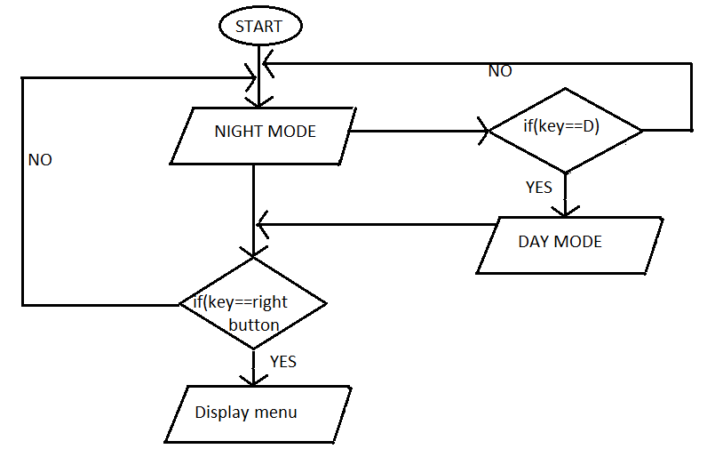
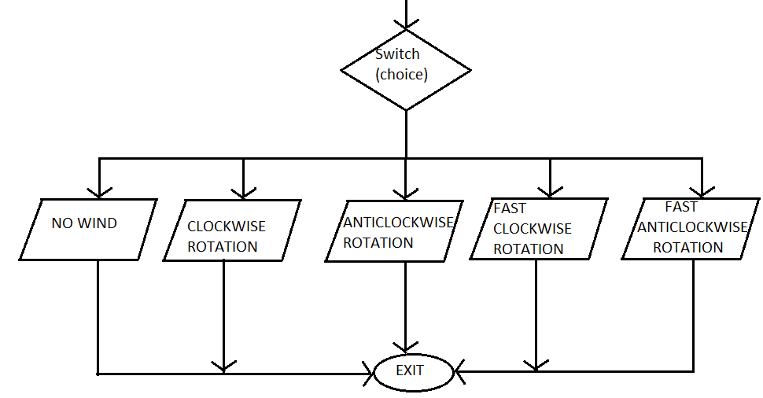
Flow Chart

Slide 10
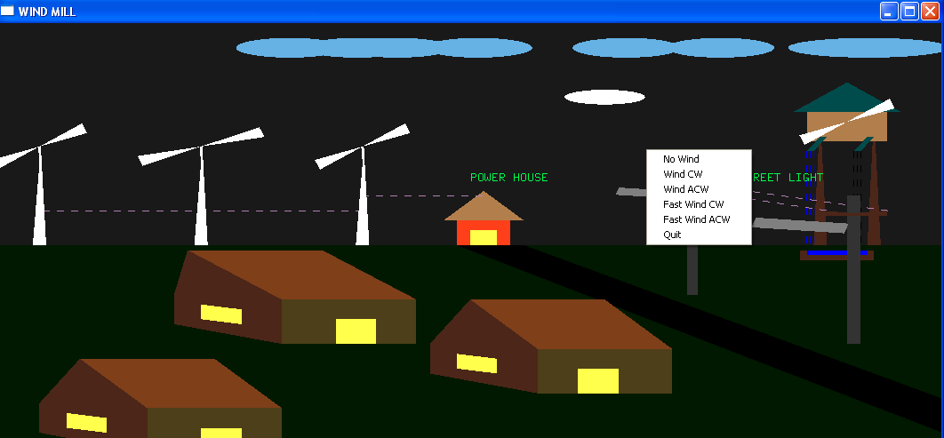
RESULT AND SNAPSHOT
Snapshot showing menu for user interface.

Slide 11
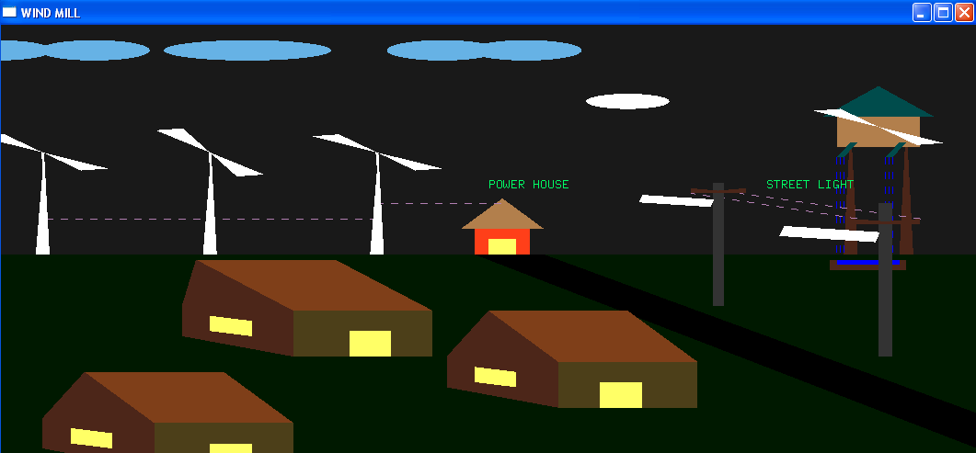
Snapshot of rotation of clockwise

Slide 12
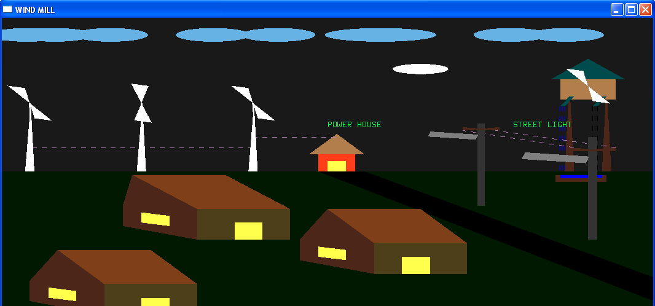
Snapshot showing rotation of anticlockwise

Slide 13
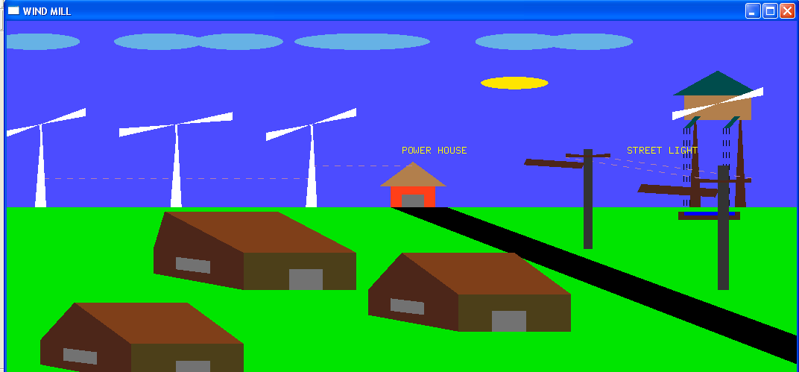
Snapshot showing day mode of project

Slide 14
Snapshot showing menu for user interface

Slide 15
CONCLUSION AND FUTURE ENHANCEMENT
Conclusion:
Designing and implementing project in graphics is a great experience. Electric power generation through windmill simulation is about to show how we efficiently make use of renewable energy using OpenGL functions. This project consists of many user defined function such as increasing windmill fan speed clockwise and anti-clockwise and movement of clouds
Future Scope:
Further development in the project can be done by illustrating graphically some other conditions other than what we have illustrated and some more advanced techniques that are recently used can be implemented. It can be made still more attractive using implementation of wind mill and make it user interactive

Slide 16
REFERENCES
Interactive Computer Graphics a Top-Down Approach with OpenGL – Edward Angel, 5th edition, Addison-Wesley, 2008.
Introduction to the Design and Analysis of Algorithm – AnanyLevetin, 3rd edition, 2007.
Computer Graphics using OpenGL- F.S.Hill,Jr. 2nd edition, Pearson education, 2001.
www.aw.com/cssupport
www.opengl.org

Slide 17
THANK YOU
MANJUNATH JOGI H K [4JN16CS038]
SURYA S [4JN16CS108]
NIKHIL K A [4JN16CS048]

